Slide 1
standards and standardization
Introduction to

Slide 2

Danish Standards
Who are we?
Denmark's official standardization organization
Founded in 1926
Private foundation
130 employees in Copenhagen + 20 in Løgstør
Partnership with the Ministry of Industry

Slide 3

Leaning objectives
The overall objective is to understand what standards are and what standardization is
Why standards exist and why they are important
Different types of standards
De jure vs. de facto standards
How standards create value

Slide 4
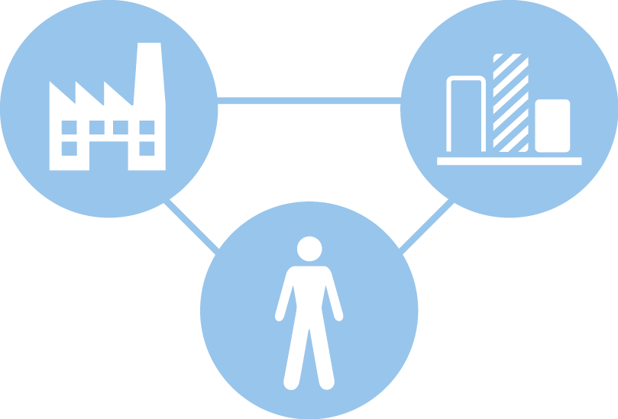


Standards create coherence
Standards CONNECT businesses, customers and markets...
... through a clear COMMON UNDERSTANDING
products, services and processes...
... that ensure effective MARKET ACCESS for companies
Notes:
Standards are a common language that makes us understand things the same way.
Standards give us all a unique global language that ensures that companies' products and services fit into the contexts in which they are to be included. Standards are common voluntary guidelines that make us understand things the same and that we can be sure of what we work together on or buy from each other – whether it's between businesses, authorities or consumers. It creates trust and security.
For businesses, the use of standards means much more efficient market access – without hampering companies' opportunities for innovation and development. The standards are just the solid foundation that makes new solutions actually work where you see a potential market.
There are over 27,000 different standards – for everything from quality requirements and hard product specifications, e.g. the size of screw lids, to process descriptions and principles of management and collaboration.
It is therefore not entirely simple to define what a standard is.
Standards ensure that all kinds of unique products, services and processes can interact with each other and the rest of the world.

Slide 5





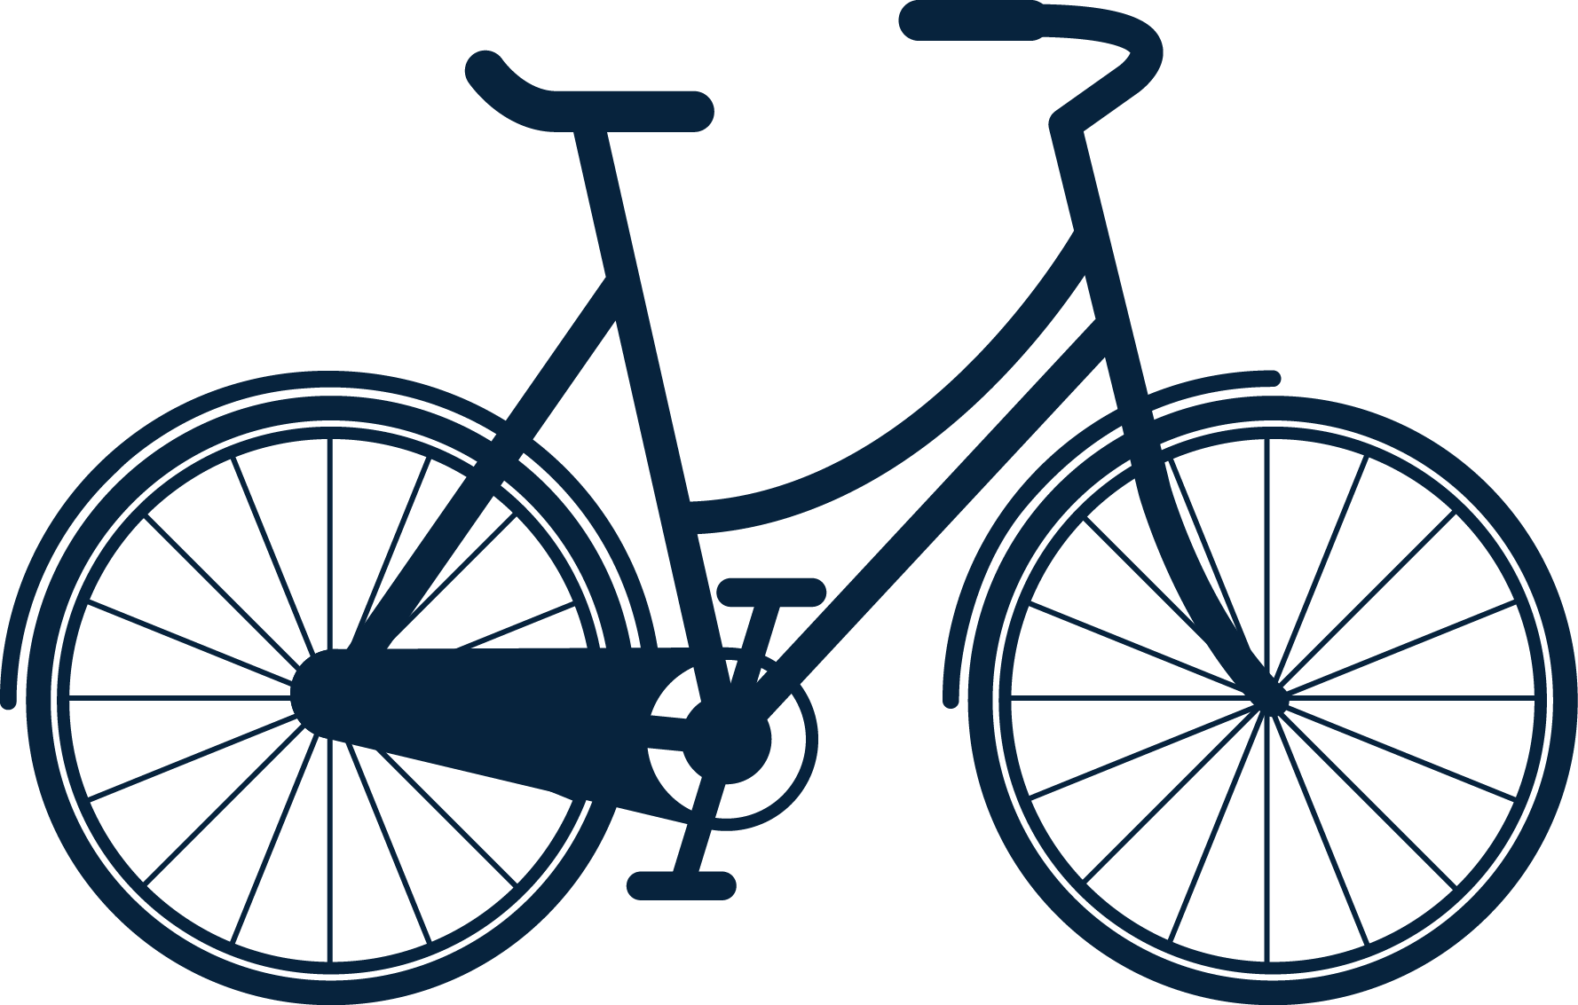
Standards make the world function better
Notes:
(standarder i hverdagen)
Standards not only have an impact on business, but also play an important role for all of us in everyday life.
Standards have become such a natural part of our everyday lives that we often do not give them a thought - although many of them are of great importance to us.
Just imagine if the light bulb didn't fit the lamp, if the screw didn't fit the nut, if the USB connector only fit into some PCs, or if no one agreed on fundamental management and quality principles. That would not be very effective.
Standards are used largely and small, in the whole and detail, locally and globally. There are standards for everything from the swing stand in the playground to the wing of the windmill.

Slide 6
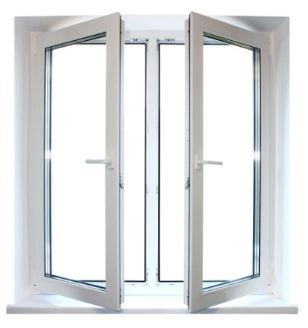
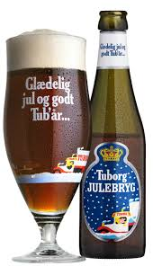
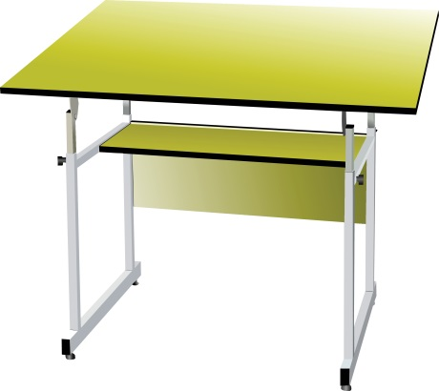


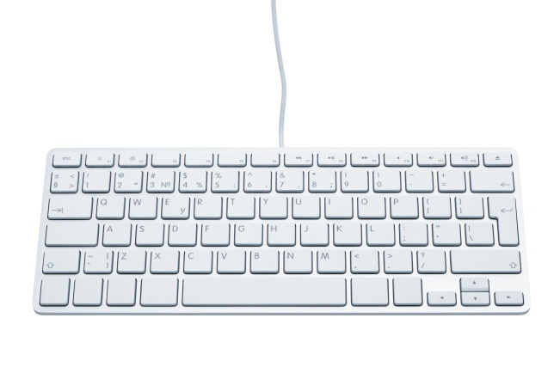
Standards are everywhere
  Take a look around!
DS/EN 12210
DS 53 – Glass bottles for beer
DS/EN 62680
DS/EN 1729
DS/ISO/IEC 9995
DS/EN 16063

Slide 7


A world without standards

Slide 8
The characteristics of a standard
Voluntary and market driven
Open to all
Developed in technical committees at national, European or int. level
Consensus-based
Formal voting procedure
Approved by a recognized body
Notes:
Standards are voluntary - It is generally optional to use a standard. However, there are a few exceptions where you have to comply with a standard. This is the case:
- when an undertaking advertises that a product or service meets the requirements of a given standard,
- where a contract or labelling scheme states that a product or service meets one or more standards,
- where laws/regulations or EU directives require certain standards to be followed.
- The decision to develop new standards is driven by market needs/requests. Fx development of circular economy standards – fx. Terminolog – what do we mean when we say circular economy
– every interested party can participate in the making of a standard and provide comments when a standard is submitted to public consultation.
- Standards are developed in technical committees
– all standards are subject to dialogue in order to establish general agreement and by a process that involves seeking to take into account the views of all parties concerned and to reconcile any conflicting arguments (definition of consensus from EN 45020). Afterwards, to get it approved, it goes through a formal vote procedure.
– a recognized standards body such as CEN, CENELEC, ISO, IEC or a national standards body has approved the document and that the document has gone through the necessary procedures, public consultations, etc.

Slide 9
Different types of standards
Products - e.g. paper size, data formats
Performance - e.g. breaking strength, ergonomics, sound tolerance
Methods - e.g. tests, chemical analysis
Symbols - e.g. pictograms, machine symbols, classification systems
Terminology - definitions of basic terms in different industries
Service - e.g. tourism
Management systems – e.g. food safety, quality, energy, environment, information security
Different requirements
Standards can set out different requirements for different things.
They may describe procedures, test methods, specify specifications or define professional terms.

Slide 10

The value of standards from different perspectives
Society
Companies
Participants
Reduces trade barriers
Builds trust in products in consumers
Documents the quality and safety of consumers and authorities
Ensures interoperability
Gain knowledge that can be used in their production and product development
Shows the quality and safety of products
Accesses (new) customers and markets (export)
Can test their products
Influence standards
Learn about new standards
Gain knowledge about competitors and new markets
Networking

Slide 11
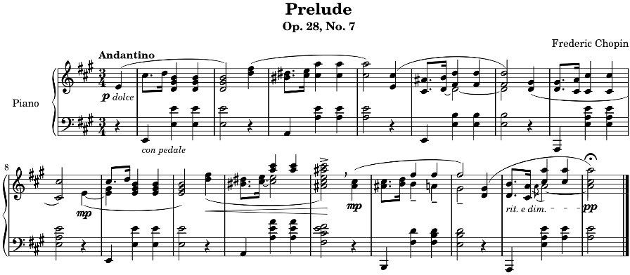
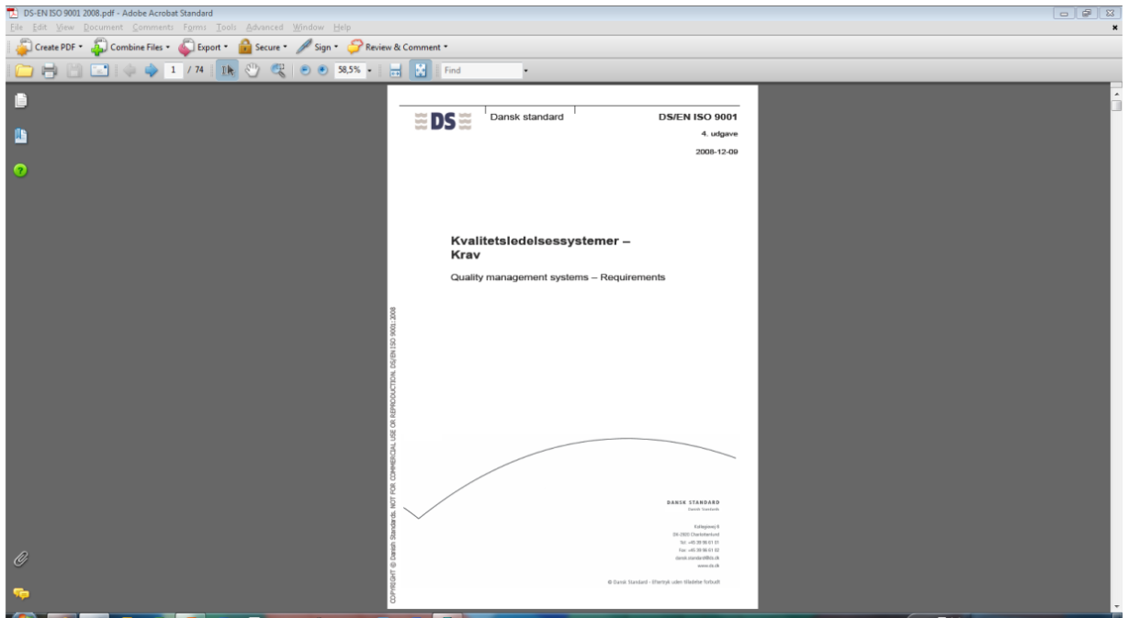

De jure vs. de facto standards
De jure
Formal standards
Voluntary
Consensus-based
Created in an open process
Approved by a formal standardization organization (In Denmark: Danish Standards)
De facto
Consortia
Industry standards
Non-consensus-based
Closed Process
De jure
De facto
DS/ISO 32000
Document management
Notes:
De jure and de facto standards are quite distinct and subject to different requirements in terms of preparation, process, revision etc. De jure standards are formal standards – standards developed by standardisation organisations. This can be done in different ways, after different concepts/rules etc.
De facto standards can be developed in consortia or come into being as an effect of market dominance. The process being open only for those invited to join characterizes this way of developing standards. Consortia are often formed with the purpose of advancing a particular technology and standards are developed to promote practices set by a single company (fex Apples, Microsoft or Blue Ray)
By developing a standard in this way, companies or consortia can acquire a large market share by dominating the market
Formal standards – standards developed by official standardization organizations. These organizations can be international (like ISO and IEC), regional (like the European CEN, CENELEC, ETSI) or national (like AFNOR, DIN, DS, etc.) and have been given formal recognition to produce formal standards.
The remaining group of standards, i.e. standards that are not developed by one of the above-mentioned recognized bodies. These are standards that have gained currency over time e.g. music notes. Other de facto standards could be a result of one or more companies products where the products become the ‘standard’ on the market.
ISO 32000 is the family of ISO standards that defines the core PDF specification, as identified by the PDF version number. All other PDF subset specifications depend upon a specific core PDF version.
Hverken fodbold, alfabetet, øl eller noderne har officielle standarder. De er normer opstået af sig selv over tid, fordi vi mennesker har fundet det hensigtsmæssigt, at vi gør visse ting på samme måde.

Slide 12
Do you know any standards?
Or de jure standards?
Are they de facto standards?

Slide 13

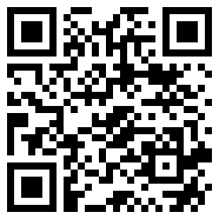
Were you paying attention?
https://dansk-standard.involve.me/what-is-a-standard

