Slide 1
Management systems standards
Introduction to
What are they and what is ISO 9001?

Slide 2
Learning objecti- ves
The overall learning objective is,
to understand what management system standards are.
Understand what management systems and standards are and why they exist
Different types of management standards
Understand ISO 9001 - Quality Management

Slide 3
What is a management system?
A management system is the way in which an organization manages the interrelated parts of its business in order to achieve its objectives.
These objectives can relate to a number of different topics, including product or service quality, operational efficiency, environmental performance, health and safety in the workplace and many more.
Notes:
The level of complexity of the system will depend on each organization’s specific context.
For some organizations, especially smaller ones, it may simply mean having strong leadership from the business owner, providing a clear definition of what is expected from each individual employee and how they contribute to the organization’s overall objectives, without the need for extensive documentation.

Slide 4
A management system is made up by management standards
In order to structure the management system, one or more different management standards are used.
These can be standards for e.g.
Quality management (ISO 9001)
Environmental management (ISO 14001)
OHS (occupational health and safety) management (ISO 45001)
Food safety (ISO 22000)
Energy management (ISO 50001)
Social responsibility (ISO 26000)
These management standards follow the same structure, making it easier to implement new management standards.
Management standards contain a certain number of requirements that the company must comply with if it wishes to be certified.
A certification is done through an accredited organization (e.g. Bureau Veritas, DNV or Lloyds) and must be renewed every 3 years.

Slide 5
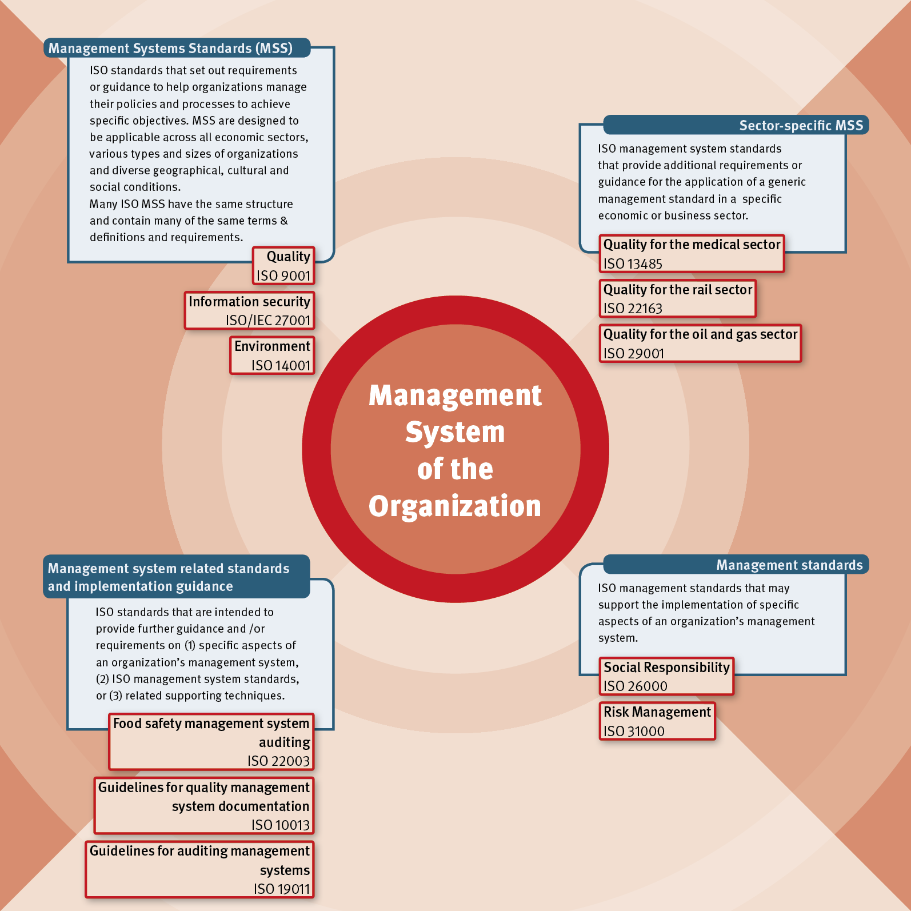
Management standards, management system standards and related standards
The Big Picture
MANAGEMENT SYSTEMS STANDARDS (MSS)
SECTOR-SPECIFIC MSS
MANAGEMENT SYSTEM RELATED STANDARDS AND IMPLEMENTATION GUIDANCE
MANAGEMENT STANDARDS
Notes:
Top left: Management system standards set requirements that enable organizations to achieve their goals in different areas. Management system standards are generic and can be used by all industries.
Top right: Management system standards have also been developed for specific sectors such as pharmaceuticals, oil and gas.
Bottom left: Several guides have been developed to help organizations prepare correct documentation and carry out audits.
Bottom right: Several management standards aim to support other standards – this can be risk management and social responsibility, for example. These cannot be certified.

Slide 6

Benefits of applying management standards
Benefits for a company implementing a management system
More efficient use of resources
Improved financial performance
Improved risk management
Protection of people and the environment
Increased ability to deliver consistent and improved products and services, increasing value for customers and other stakeholders.
Bottom line

Slide 7

Group exercise
In groups of 5
Discuss what you think characterizes quality? What do you think it is about? (you have 5 min. to discuss)
Identify 3-4 key quality related principles that you think would be necessary for a quality management system! (10 min.)
Present 3-4 key principles to the rest of the groups (3 min. Per group presentation)
What is a principle?
A principle is a basic rule that guides or influences thought or action.
In other words, principles guide our decision-making. We want to make decisions that support our principles!

Slide 8

ISO 9001
The standard for quality management systems

Slide 9
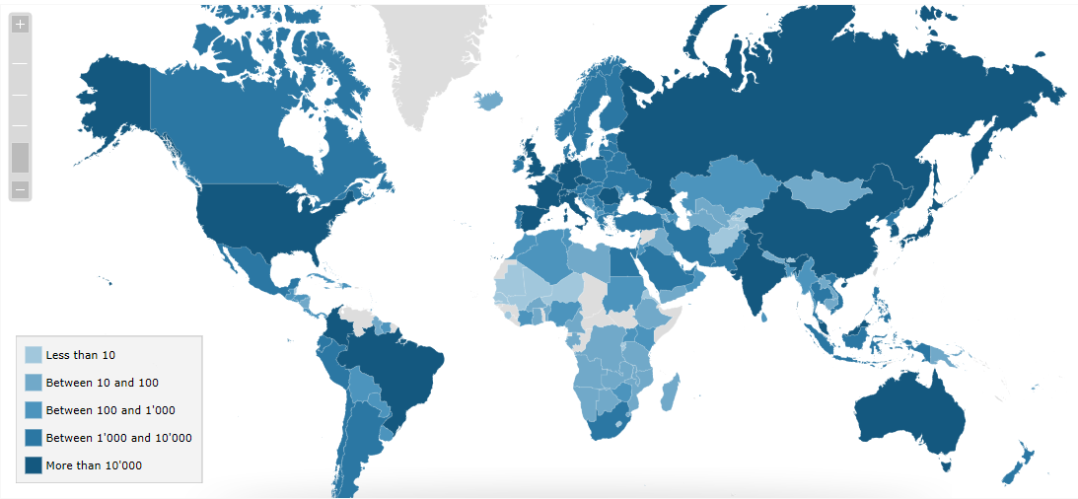
ISO 9001 - the most commonly used management standard
ISO 9001 is a management system standard for quality management and the standard by which most companies in the world are certified.
The number of ISO 9001 certified companies worldwide has in recent years been just over 1 million.
Notes:
Applies to all organizations – often a requirement from the market – improve quality – helps organizations meet customer needs - public and private sector tender situations

Slide 10
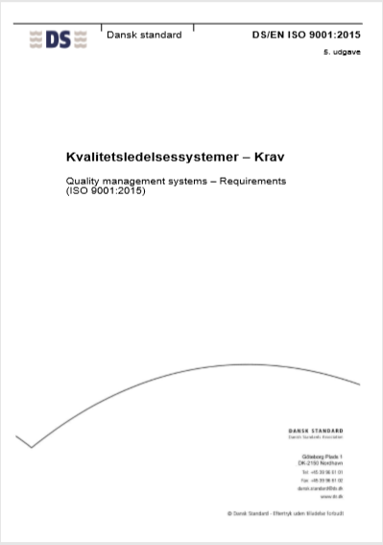
Why is ISO 9001 so common?
ISO 9001 specifies requilremsent
ISO 9001 sets out the requirements for a quality management system. It helps businesses and organizations to be more efficient and improve customer satisfaction.
It is based on a number of quality management principles including continuous improvement.
It helps ensure compliance with customer requirements and relevant legal and regulatory requirements.
It sets the criteria for a quality system and is the only standard in the 9000 family after which a company can be certified.
It can be used by any organization, large or small, regardless of its scope.
Notes:
The potential benefits to an organization of implementing a quality management system are:
The ability to consistently provide products and services that meet customer and applicable statutory and regulatory requirements ;
Facilitating opportunities to enhance customer satisfaction ;
Addressing opportunities and risks associated with its context and objectives, and
The ability to gain the external recognition of conformity to specified quality management system requirements.
PLADS TIL INDIVIDUALITET:
It is not the intent of this International Standard to imply the need for uniformity in:
The structure of different quality management systems
Alignment of documentation to the clause structure of this International Standard
The use of specific terminology of the International Standard within the organization.

Slide 11

Key QMS principles
Principle 1
Principle 3
Principle 5
Customer focus
Engagement of people
Improvement
The primary focus of quality management is to meet customer requirements and to strive to exceed customer expectations.
Competent, empowered and engaged people at all levels throughout the organization are essential to enhance its capability to create and deliver value.
Successful organizations have an ongoing focus on improvement.
Principle 2
Principle 4
Principle 6
Leadership
Process approach
Evidence-based decision-making
Leaders at all levels establish unity of purpose and direction and create conditions in which people are engaged in achieving the organization’s quality objectives.
Consistent and predictable results are achieved more effectively and efficiently when activities are understood and managed as interrelated processes that function as a coherent system.
Decisions based on the analysis and evaluation of data and information are more likely to produce desired results.
Principle 7
Relationship management
For sustained success, an organization manages its relationships with interested parties, such as suppliers.

Slide 12
All management standards work with PDCA
Plan
Do
Check
Act
Plan a change or test, aimed at improvement
Carry out the change or test, preferable at a small scale
Study the results – what did we learn? What went wrong?
Adopt the change, abandon it, run through the cycle again!
Continuous focus, continuous change
Notes:
PDCA er en 4-trins iterativ metode brugt af virksomheder til kontrol og løbende forbedringer. Den er udviklet af W. Edwards Deming som er faderen til moderne kvalitetskontrol.

Slide 13
The content of ISO 9001 - overview
PLAN
DO
CHECK
ACT
4. Organisation framework and condition
Understanding the organization and its framework and condition
Understanding stakeholders' needs and expectations
5. Leadership
Leadership and commitment
Policy
Determination of the scope of the QMS
The quality management system and its processess
Roles, responsibilities and authorities in the organization
6. Planning
7. Support activities and functions
8. Operation
9. Performance evaluation
10. Improvement
Actions to address
risks and opportunities
Quality goals and planning to achieve them
Planning changes
Resources
Competence
Awareness
Communication
Documented information
Operational planning and management
Requirements for products and services
Development of products and services
Management of processes, products and services from outside
Production and provision of services
Release of products and services
Deviant Output Management
Monitoring, revies, analysis and evaluation
Internal audit
Management evaluation
Generally
Nonconformity and corrective action
Continuous improvement
Notes:
ISO 9001 visuelt fremstillet fra kapitel 4 – 10. Det er i disse kapitler at kravene beskrives, hvorimod at kapitel 0-3 er af informativ karakter.

Slide 14
From strategy to quality management system
The company's strategy
Intended results of the management system
Internal and external issues
Stakeholder expectations
Quality management takes point of departure in the company’s strategy.
The strategic objectives are cascaded in the management system with a focus on external and internal issues that may affect reaching the objectives.
The system also addresses the expectations of the customers.
Then the system addresses risks.
Finally all the identified observations are integrated into the business processes and evaluated – e.g. through internal audits, evaluations, reviews etc.
The results of these are put back into the system as improvements to processes and procedures.
Risk management
Integration into the business processes
Evaluation
Improvements

Slide 15
Exercise: Design your own QMS
Think of an organization from your life that could benefit from a QMS e.g. your workplace, sports club or a cafe - just think of any example!
In groups of 5 people select the best example (5 min)
Define the objectives of your QMS (10 min) (see text to the right)
Identify your organization’s key processes for meeting one of your organizations objectives as well as your customers’ needs. (10 min)
Present what key process you came up with (5 min each)
The objective may be in the form of critical success factors. This helps an organization in emphasizing the journey towards accomplishing its mission. These performance-based measures deliver a gauge to determine compliance with its objectives.
Some Critical Success Factors are:
Financial Performance
Product Quality
Process Improvement
Customer Satisfaction
Market Share
Employee Satisfaction

